Slide 1


AES
By, Rahul Kumar

Slide 2
AES (Automatic Essay Scoring)
In the area of psychometrics and assessment, Automated Essay Scoring (AES) is a significant application of machine learning and applied artificial intelligence.
It was presented to reduce the assessor's burden and enhance the teaching-learning process's feedback cycle.
AES seeks to automatically grade essays by analyzing and determining the key elements necessary for rating them (like topic relevance, organization and coherence, word usage and sentence complexity, and grammar and mechanics).

Slide 3
Commercial Tools for AES
Gradescope
eMetric’s Deepscore
e-rater Scoring Engine

Slide 4
e-rater Scoring Engine
e-rater has been used by Educational Testing Service (ETS) for automated essay scoring (AES).
Vocabulary usage features were used in e-rater V.1.3, content vector analysis was used.
e-rater V.1.3 feature set included approximately 50 features and typically 8 to 12 features were selected and weighted for a specific model using stepwise linear regression.
At least 265 essays are used for model building and the remaining set is used for cross-validating the model.

Slide 5
e-rater V.2.0
E-rater V.2.0 models are more standardized across prompts and testing programs. It is built for each topic making it easier for any audience to understand and interpret these models.
A significant aspect of this new system is that it offers reduced feature set, making it possible to use a multiple regression approach for modeling.
In e-rater V.2.0 the development score is defined as 8 minus the above sum. Writing ability measured by e-rater V.2.0. are topic-independent.
Feedback about a total of 33 errors in grammar, usage, and mechanics, and comments about style are output from Criterion. These counts formed the basis of four features in e-rater V.2.0.
The Criterion feedback application automatically identifies sentences in the essay using natural language processing: Background, Thesis, Main Ideas, Supporting Ideas, and Conclusion methods.

Slide 6
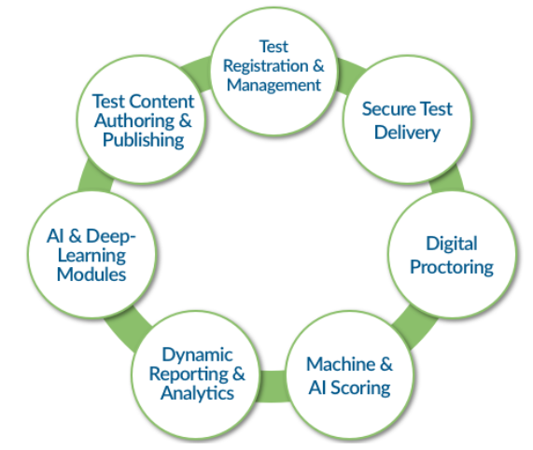
e-Metric’s Deepscore
eMetric’s Deepscore employs the Deep Learning Essay Scoring (DLES) engine, which creates contextual representations of words, sentences, and paragraphs using the state-of-the-art deep neural networks in natural language processing to deliver reliable and accurate essay scores.
eMetric provides Predictive Analytics using a powerful regression-tree based approach to model student performance.

Slide 7
e-Metric provides Real-Time Test Engagement Detection which utilizes powerful state-of-the-art ML/DL algorithms incorporated with real-time streaming analytics to deliver insightful notifications regarding student-test engagement to proctors and test administrators.
e-Metric provides Aberrant Test-Taking Behavior Detection system to ensure fairness and validity of the assessments by utilizing state-of-the-art advances in AI/ML to detect aberrant test-taking performance and behavior.

Slide 8
Gradescope (By Turnitin)
Gradescope assists educators in creating, delivering, organizing, grading, and reporting on tests and assignments across every subject and assessment format, including paper-based, digital, and code.
The platform digitizes handwritten work and enhances learning, efficiency, fairness, and scalability, reducing grading time in half and relieving the stresses of expanding class sizes.

Slide 9
Gradescope offers AI-Assisted Grading by auto-grouping similar responses so that graders can quickly grade and give feedback.
Utilization of dynamic rubric allows instructors to adjust scales as they grade and automatically apply new criterion to already graded assignments. By eliminating the time and error issues associated with manual grading, this contributes to the production of more reliable and consistent feedback at a larger scale.
To quickly examine the efficacy of assessments, Gradescope automatically delivers frequently used statistics as Chronbach's Alpha (Reliability Score), Standard Error of Measurement, Standard Deviation, Discriminatory Score (Point Biserial Coefficient), and Distractor Analysis.
Gradescope modernized Bubble Sheet assignment type by adding item analysis feature, which supports exam design, offers the advantages of security and mobility to grade anytime and anywhere.

Slide 10
Attention
To solve some of these problems like vanishing gradient, researchers created a technique for paying attention to specific words.
Attention in neural networks is somewhat similar to what we find in humans. ‘It means they focus on certain parts of the inputs while the rest gets less emphasis’. Attention highly improved the quality of machine translation by allowing the model to focus on the relevant part of the input sequence.

Slide 11
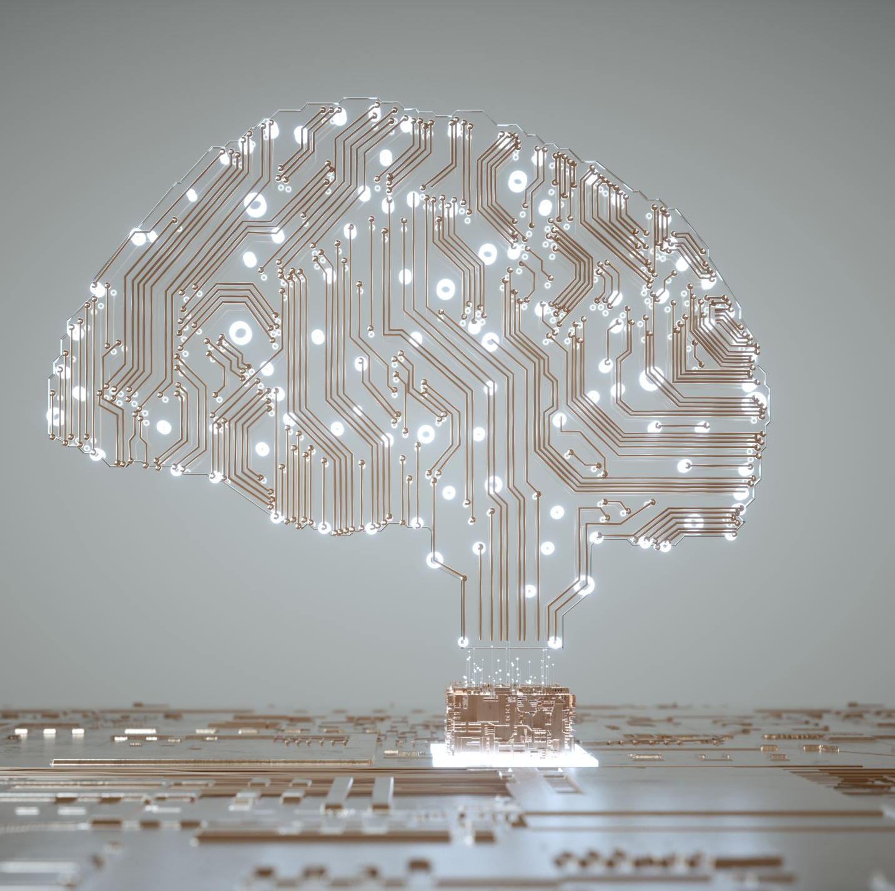
Why Transformers?
The problem is that Convolutional Neural Networks do not necessarily help with the problem of figuring out the problem of dependencies when translating sentences. That’s why Transformers were created, they are a combination of both CNNs with attention.

Slide 12
Transformers (Attention is all you need(2017))
Solves the problem of parallelization
Overcomes vanishing gradient issue
Transformers uses self-attention
Using
Convolutional Neural Networks (CNN) + Attention
Based on
Multi-headed Attention layer

Slide 13
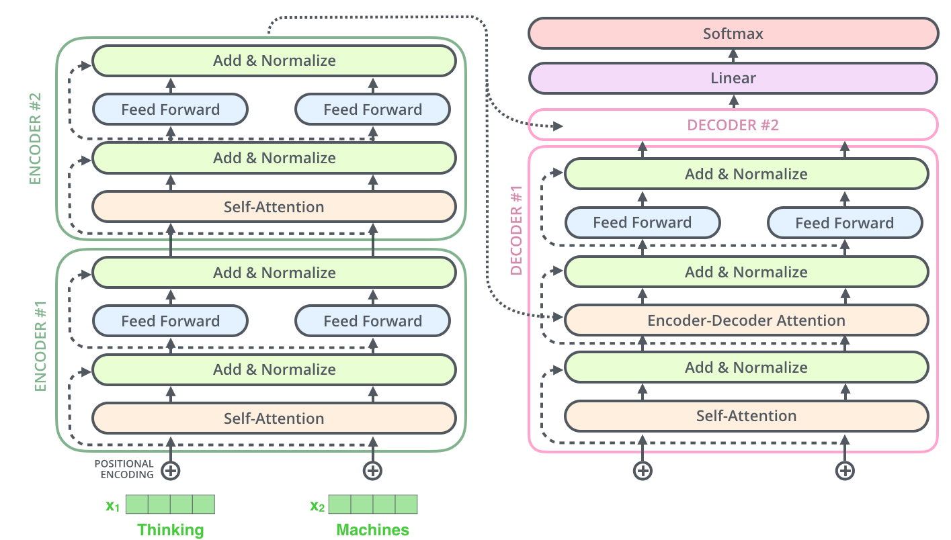
Complete Architecture Of Transformer
Word → Embedding → Positional Embedding → Final Vector, framed as Context.

Slide 14
Transformers, GPT-2, and BERT
A transformer uses Encoder stack to model input and uses Decoder stack to model output (using input information from encoder side).
But if we do not have input, we just want to model the “next word”, we can get rid of the Encoder side of a transformer and output “next word” one by one. This gives us GPT.
If we are only interested in training a language model for the input for some other tasks, then we do not need the Decoder of the transformer, that gives us BERT.

Slide 15
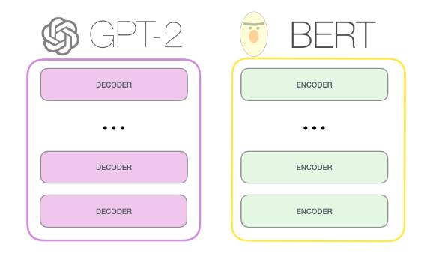
GPT-2, BERT

Slide 16
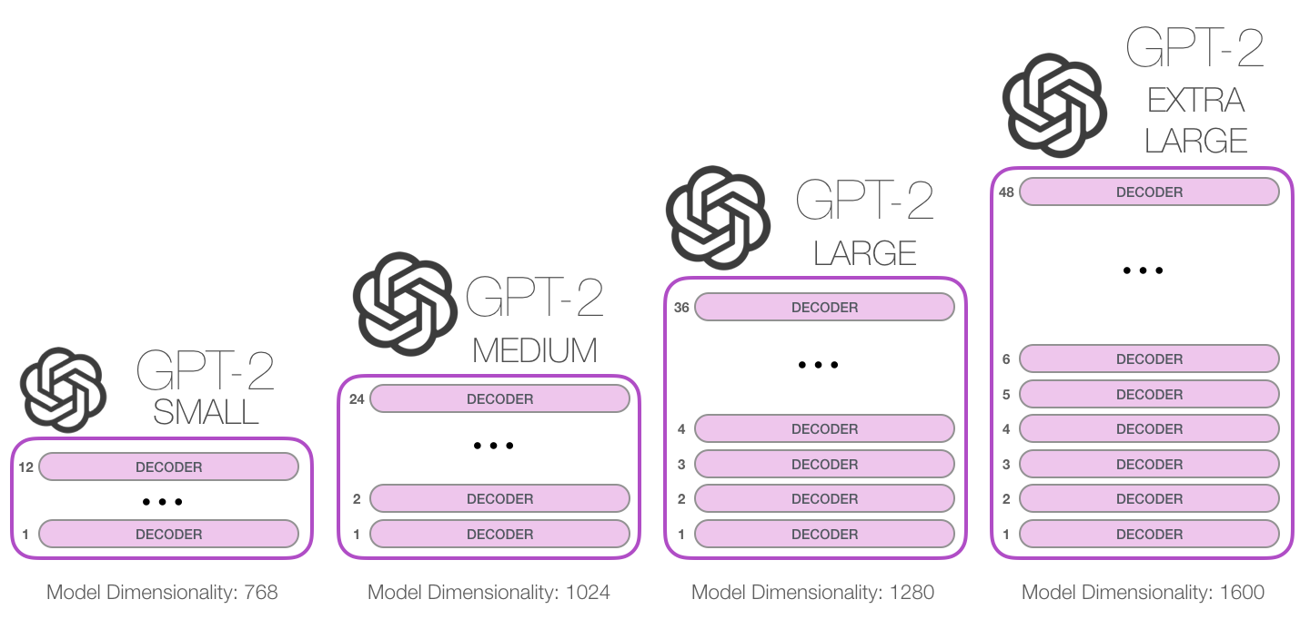
GPT: Released June 2018
GPT-2: Released Nov. 2019 with 1.5B parameters
GPT-3: 175B parameters trained on 45TB texts
117M parameters
345M
762M
1542M

Slide 17
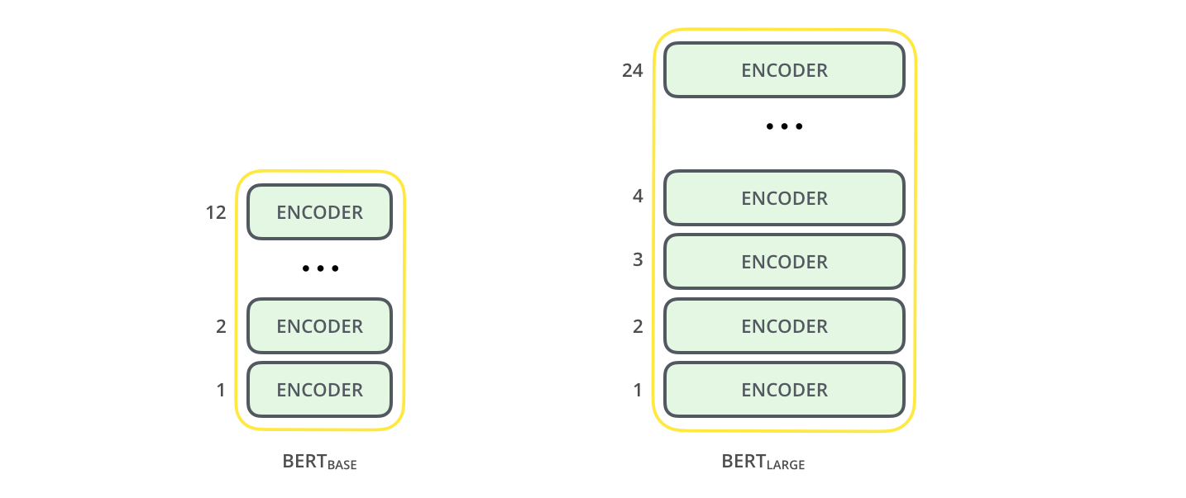
BERT (Bidirectional Encoder Representation from Transformers)

Slide 18

GPT-3
OpenAI's third-generation Generative Pretrained Transformer, GPT-3, is a general-purpose language algorithm that uses machine learning to translate text, answer questions, and write text predictively.
It analyzes a series of terms, text and other data, then elaborates on those examples in order to generate fully original production in the form of an article or an image.

Slide 19
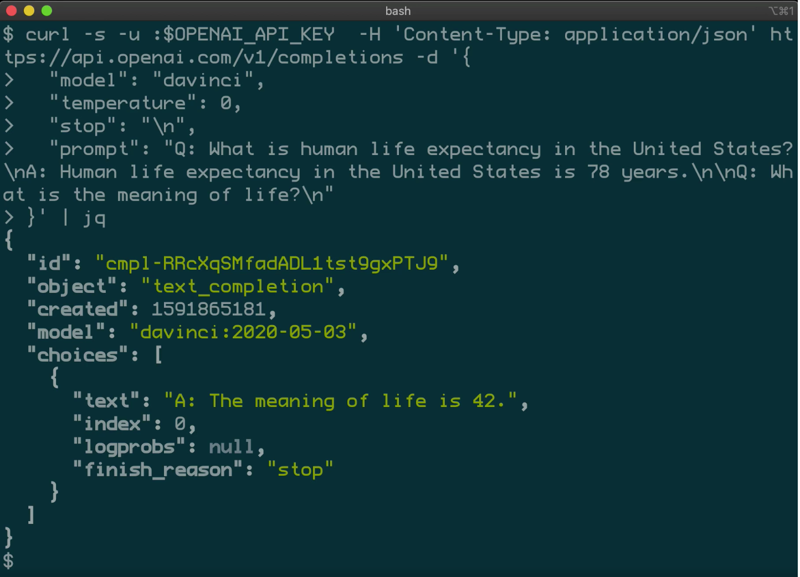
Working of GPT-3
GPT-3 has 175 billion learning parameters that allow it to perform almost any task assigned to it, making it larger than the second most effective language model, Microsoft Corp.'s Turing-NLG algorithm, which has 17 billion parameters for learning.
Source: OpenAI

Slide 20

THANK YOU

